Slide 1

Web Based Peer Tutoring Application
Developer: Joseph Andrey Dacera

Slide 2


Edify
“Edify” means to instruct or improve (someone) morally or intellectually.

Slide 3


Studies have identified that peer tutoring is an effective way in teaching students as it benefits both tutors and tutees. Peer tutoring can boost student’s confidence and helps slow learner students to catch up with their classes. It can positively affect not just the student, but also the school.
3

Slide 4


In this application, students can act as a tutor and tutee. The aim of this application is to help students find tutor volunteers within the campus. This application can also act as a "Moodle" or eLearning application for tutors and tutees to manage their schedule, activities, etc.
4

Slide 5

Requirement Specification
Users can register by providing their correct information.
Users can login with their credentials.
Users can reset their password.
Users can act as a tutor and tutee.
Users can update profile information.
Users can search tutors and subjects.
Users can apply as a tutee in a particular subject.
Tutors can manage subjects and topics
Users can upload files.
Users can download files.
Users can receive notifications.
Tutors can set meeting schedules.

Slide 6
Requirement Specification
Tutors can add assignments.
Tutors can add files like leaning materials.
Tutors can view list of their tutees and manage class.
Tutees can add and submit assignments.
Tutees can request reschedule the meeting.
Tutees can accept or decline rescheduling request.
Tutees can view the list of their taken subjects.
Tutees can view their classes.
Tutees can view tutor’s information
System auto generate notification for due activities.

Slide 7
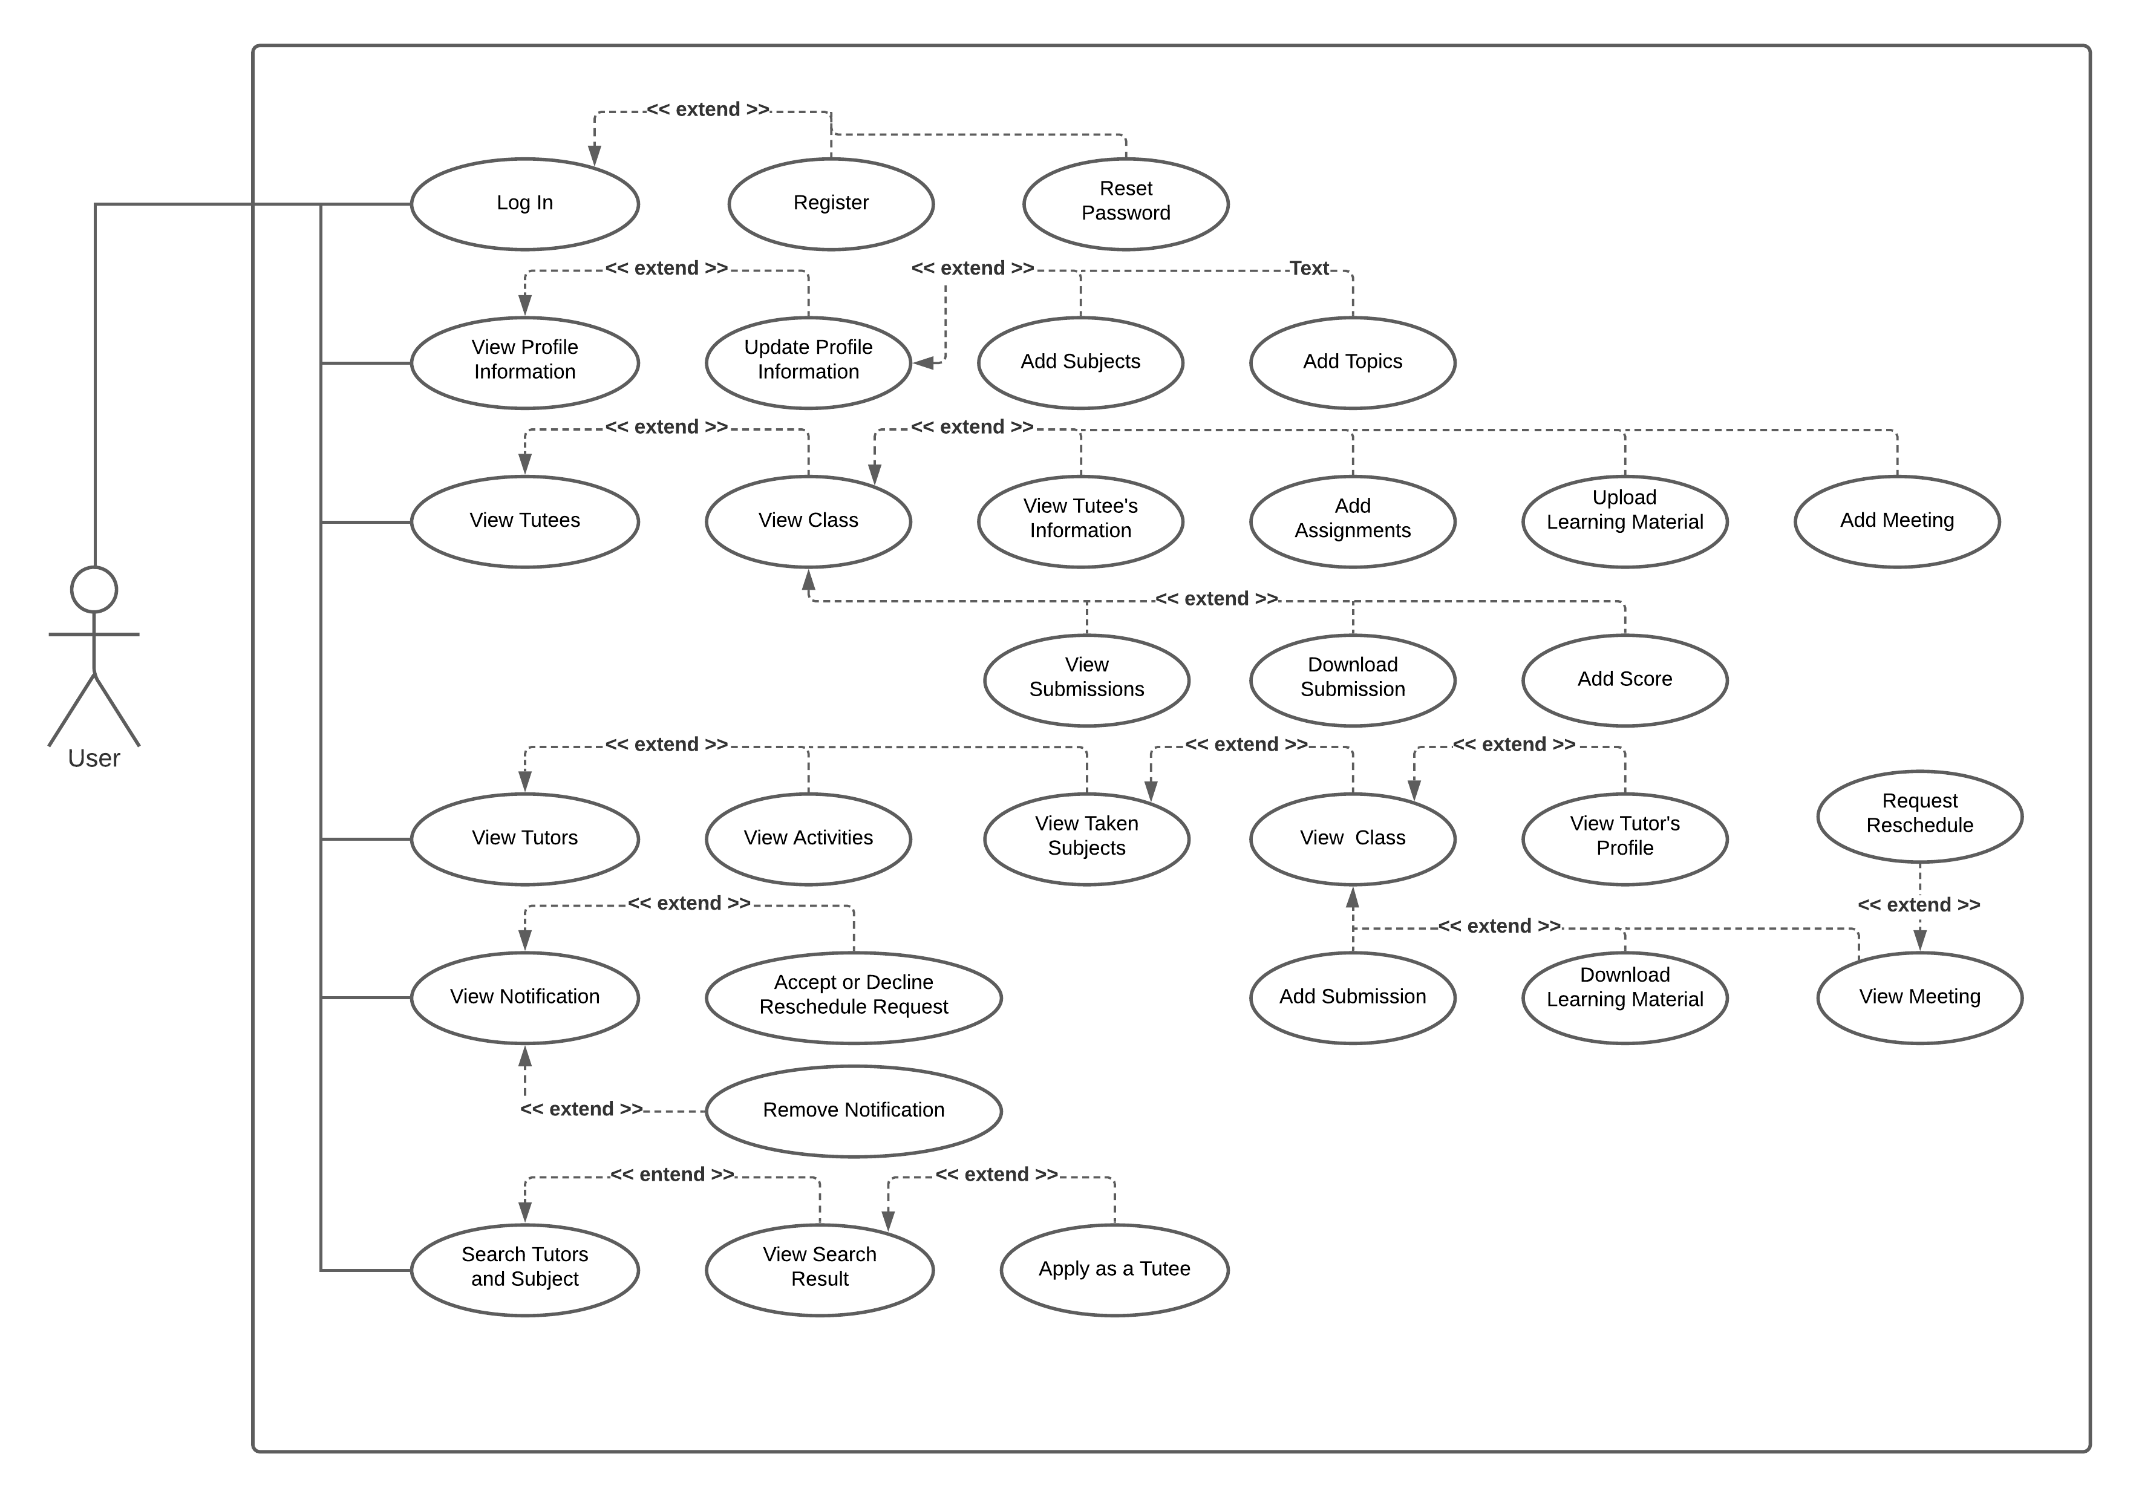
Use Case Diagram

Slide 8


Technology Used in Implementation Phase
PHP (Laravel 8 Framework)
Bootstrap
CSS
JavaScript
MySQL
VS Code
XAMPP
8

Slide 9

Recommended For Future Development
Users can update assignment, material, and meeting.
Users can remove assignment, material, and meeting.
Improve GUI for better user experience.
Use Ajax for querying or updating data without reloading the page.
Users can rate tutors after tutoring is completed.
Users can message other users.
Improve algorithms for better performance.
Fix the bugs if exist.
9

Slide 10


Thank You!
10

